Slide 1
How to Succeed in OSCEs
GKT Medical Students’ Association
Leah Asante - Tanzim Shahid - Ebrahim Nasser

Slide 2
Stage 2 Year 3 OSCEs
The OSCE assesses the core knowledge and skills you have learnt throughout Stage 1 and Stage 2.
There are five main station types:
History
Communication
Examination (including Living Anatomy)
Practical skills/Procedures
Assessment
The 12 stations will test content from the ten blocks covered across Stage 2 Year 2 and Year 3.
Notes:
Leah

Slide 3
History taking
This station assesses your ability to gather medical information from a patient in a focused and holistic manner.
Key components of history taking:
Introduction
Presenting Complaint
History of Presenting Complaint
Drug History, Family History, Social History
Ideas, Concerns and Expectations
Notes:
Leah

Slide 4
Learning scenario
Example vignette:
You are a Stage Year 3 medical student attached to the Ageing block.
Please take a focused history from Ms Saima Lee, a 71-year-old lady who has presented to the hospital after fainting at the bus stop. At 6 minutes the examiner will ask you questions.
How are you going to approach this station? What are your differentials? Any investigations in mind?
Notes:
Leah

Slide 5
Learning Scenario - Syncope
Presenting complaint + associated symptoms
History of presenting complaint - before, during and after fall, any injuries e.g. head injury?
Past medical history - hypertension (ask about any heart problems, history of seizures)
Drug history - amlodipine, ramipril, multivitamin tablets
Family history
Social history - occupation, activities of daily living, living situation, ask about alcohol, diet, exercise, smoking, recreational drugs
Ideas, concerns and expectations
Differential diagnoses
Most likely: orthostatic hypotension (could be secondary to antihypertensive medication)
Most serious: seizure (unlikely)
One other: cardiogenic syncope
Investigations
Collateral history (was anyone else present at the fall?)
Bedside (A-E assessment, physical examination e.g. cardiovascular, neurological examination, lying and standing blood pressure, ECG to investigate for arrhythmias)
Bloods (FBC, U&Es, LFTs glucose - rule out hypoglycaemia)
Imaging e.g. hip x-ray, CT head
Notes:
Other symptoms: headaches, visual changes, limb shaking, muscle weakness, altered consciousness or sensation, tongue biting, faecal, urinary incontinence

Slide 6
OSCE History Taking Tips
You have limited time - once you have read the vignette, start mentally planning your approach, think of the possible diagnosis!
Remember to introduce yourself and to confirm patient name & date of birth
Begin with open questions and then narrow down for a focused history
It’s your OSCE - listen attentively but interject politely if necessary so you can ask the key history taking questions
Rule in/out the red flags!
Try to build a rapport with the patient (if patient raises a concern, don’t ignore it)
Remember to ICE (ideas, concerns and expectations) your patients
Justify your diagnosis and investigations briefly when asked by the examiner

Slide 7
Communications
There are a few topics to be aware of with a comms station:
Explaining a disease
Explaining a procedure
Explaining a drug
Explaining a referral
Vaccine information
Genetic and/or antenatal screening
Contraceptive advice
The list is endless! But has ONE common theme - the patient-centred approach!
Notes:
Tanzim
At the end of this slide ask them - “what emotions or triggers did the patient have to book an appointment”

Slide 8
Communications - General Framework
“Explore the patient’s concerns…” - this station is very much patient-led!
Beginning - build rapport and ask an open ended question
ICE BEFORE IT MELTS! - this guides the rest of the station
Brief history
Summarise the history and inform the patient what you plan to talk about
Check in with them “Does this sound like a good plan to cover?”, “Is there something else you would like to talk about”
Follow out the plan
‘Chunk and check’ “Does this make sense?” “Any questions so far?”
Summarise and collaborate
Make an offer…
Notes:
Tanzim
5) some ideas will be given on the next slide

Slide 9
Communications - consultation plans
How to explain a disease:
What is normal anatomy/physiology?
What is the disease?
Cause?
Problems and Implications
Management
*remember: conservative-medical-surgical
How to explain medication/procedure/referral:
What is it?
Reason for it
Details (e.g. how to take a drug, what the procedure or referral entails)
Monitoring
Risks and Benefits
*be mindful when using medical jargon
Notes:
Tanzim

Slide 10
Communications - example station
General Practice: Longitudinal Placement
You are a 3rd year medical student at the GP practice for placement.
Alice, 25-year-old female was discharged from the Emergency Department last week after having an asthma attack.
Take a brief history from Alice, explore how to assess her severity of asthma explore Alice’s concerns in detail.
Notes:
Tanzim
http://gums.org.au/site/wp-content/uploads/2018/09/GUMS-Year-4-Station-5-asthma-review.pdf

Slide 11
Communications - example station
I - “I think my asthma has gotten worse”
C - “I am embarrassed that I can’t use my inhaler properly”
E - “I would like some advice on how to keep on top of my inhalers to prevent going to ED again”
Brief History:
“Last Friday, I became wheezy all of a sudden whilst having lunch. I took 2 pumps of the blue inhaler but this is the worst the asthma has ever been… I’ve had asthma since I was 5 but I feel it has gotten worse… I cough a lot and become wheezy at night… I use only the blue pump and not the brown and using a spacer is inconvenient…”
Plan for consultation:
Enquire more about inhaler technique
Demonstrate inhaler technique
Offer prescribing a spacer
Discuss monitoring the asthma using a peak flow device
Simple safety netting
Offer: Offer to meet in a couple of weeks to see if asthma has gotten better and to discuss Alice’s peak flow diary
Notes:
Tanzim

Slide 12
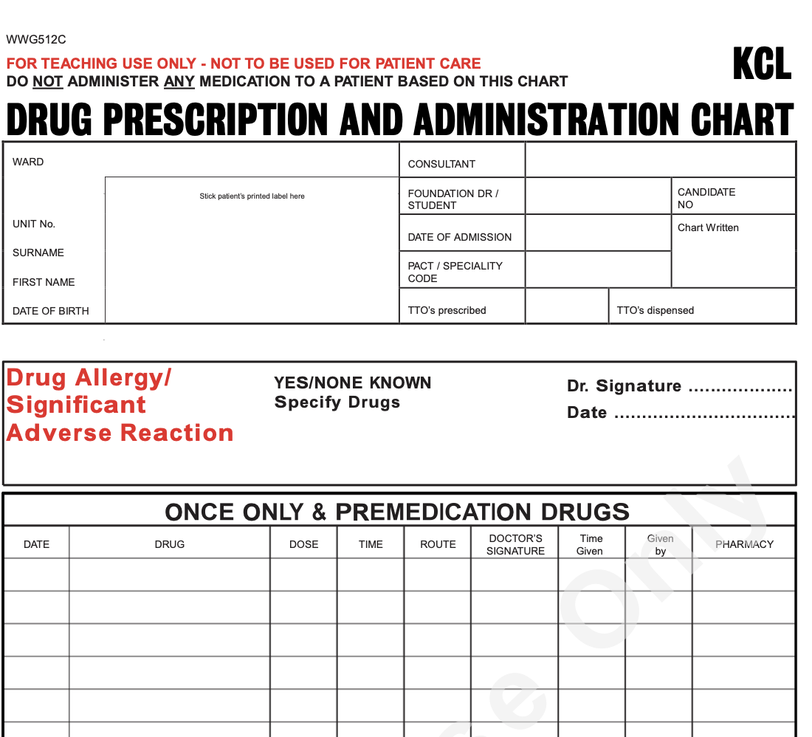
Practical skills - assessment, procedures, prescribing
Tips:
Use KCL clinical skills facilities and resources e.g. Chantler SaIL centre
Practise under timed conditions especially prescribing
Familiarise yourself with common scoring systems e.g. CURB-65, Glasgow Coma Scale
Know the normal ranges for vital signs
Revise conditions and their management plans
*See Keats Purple Guide for list of practical skills/procedures that can be assessed

Slide 13
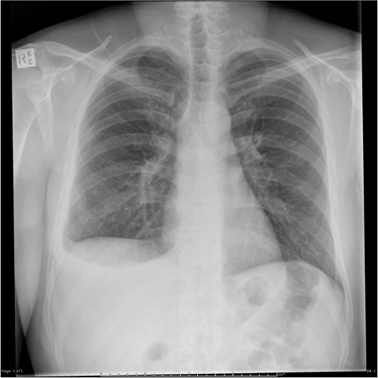
Example - X-ray Interpretation
Patient Adam Smith presented to A&E today with chest pain and difficulty breathing.
He tells the nurse he has been having a fever and a productive cough for past week and ‘woke up feeling like could not breathe today’.
A chest X-ray was performed 25 minutes ago, please describe its findings to the examiner.
Case courtesy of Assoc Prof Frank Gaillard, Radiopaedia.org, rID: 25595
Notes:
Ebrahim

Slide 14
X-ray Interpretation Framework
First steps:
ALWAYS identify the patient
Identify what is in the photo
Identify when the photo was taken and all other photo data if available
Secondly
Take a second and think what are the frameworks per XR.
Case courtesy of Assoc Prof Frank Gaillard, Radiopaedia.org, rID: 25595

Slide 15
X-ray Interpretation Framework
This is a CXR, so the frameworks we must think about are RIPE then ABCDE.
Case courtesy of Assoc Prof Frank Gaillard, Radiopaedia.org, rID: 25595

Slide 16
X-ray Interpretation Framework
RIPE:
Rotation: Are the clavicles equidistant and spinous processes vertically oriented?
Inspiration: Are 5-6 anterior ribs showing? Are both costophrenic angles there? Are the rib edges visible?
Projection: Is it AP or PA? If you cannot see scapulae in the chest it’s PA
Exposure: Vertebrae should be visible behind the heart
Case courtesy of Assoc Prof Frank Gaillard, Radiopaedia.org, rID: 25595

Slide 17
X-ray Interpretation Framework
ABCDE:
Airway: Tracheal deviation, bronchi, hilar area
Breathing: Lung fields, the pleura, look for consolidation, lesions, or fluids.
Cardiac: Look at heart size
Diaphragm: The diaphragm should not have any gas under it, keep in mind the stomach gas
Everything Else: Aorta, Bones, tissues, tubes
Case courtesy of Assoc Prof Frank Gaillard, Radiopaedia.org, rID: 25595

Slide 18
Examiner Questions
The XR stations does also test your medical knowledge.
The examiner will usually ask you questions on what you think the diagnosis is, other questions include:
Any further examinations/investigations
Management of the case
Complications of the diagnosis
Case courtesy of Assoc Prof Frank Gaillard, Radiopaedia.org, rID: 25595

Slide 19
X-ray Interpretation Tips
X-ray interpretation is a very common station
Usually given 8mins: 6 for you and 2 for the examiner
Always lead with the main framework of:
Identify the patient and photo
Talk about the image quality as well as orientation
Talk about image contents
Common stations include: Chest XR, Abdo XR, MSK, and CT Head (if you are unlucky they can get cervical spinal XR)
Take your time, this may be the only station time-pressure is not as high. Use the time to make the script in your head.
Geekymedics has some of the best resources on XRs. Test yourself on radiologymasterclass.co.uk

Slide 20
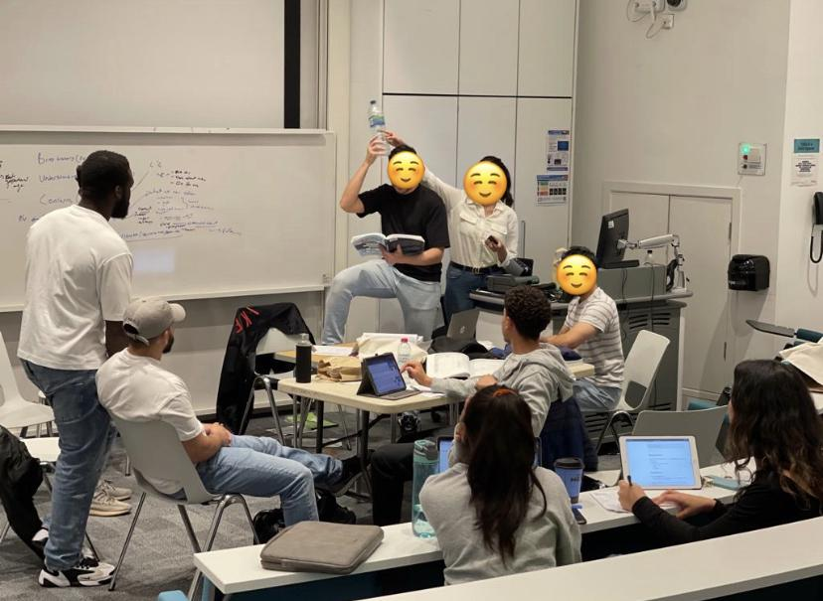
Examinations
These stations assess how well you can carry out system-based physical examination, reporting your findings in an organised and clear manner.
Examination tips:
- Practise on medics, non-medics and of course, patients!
- Practise under timed conditions
- Ask for and give honest feedback
- Use checklists when practising examinations e.g. Geekymedics checklists
- Know your signs e.g. oedema can be indicative of congestive heart failure, the abdominal scars etc
- Don’t forget general inspection - look at the objects in the station!
S2Y3 Guide on Kears contains the list of examinations that can be assessed: S2Y3 OSCE Purple Guide 2022-23 File

Slide 21
Closing advice
Reach out to your friends to organise group practice - make those med school memories!
A good night’s sleep is needed before exam days - 2 days of OSCE can be exhausting
Approach the OSCEs with a winner mindset - you might be feel that a station didn’t go well, keep on going, just like you did with the MMIs
Remember your introduction, PPE, handwashing
The vignette is in the station - reread it if you need to
Bring snacks and your resources for the quarantine period
Try to enjoy the OSCEs! - hopefully it is fun?
If you have any concerns, please raise them with the exam officers

Slide 22
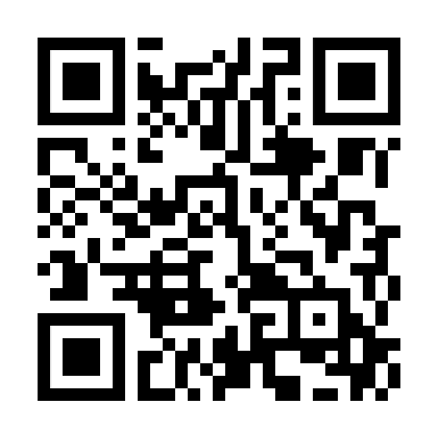
Feedback Form & Resources
Useful resources:
Keats Purple Guide
KUMEC Youtube videos
OSCE Stop website & revision guide
Geeky medics website
NHS what happens - website to direct to patients to learn about investigations and procedures

