Slide 1
Tanzim Shahid and Katherine Lazar
(THE Year 4 Duo)

Slide 2
Session topics
The Exam
Learning techniques
Revision resources
Approaching exam questions
General Advice

Slide 3
The IN-PERSON (online) Exams 23/24
Blocks: Human Development, Supporting Life, Inflammation, Ageing, Vascular, Trauma, Cognition, Movement and Senses and Cancer and Clinical Genetics
Stage 2 Year 2: three progress tests - PT1 in November, PT2 in January, PT3 in May
Stage 2 Year 3: two progress tests - PT5 in November and the summative exam PT6 in January
150 QUESTIONS – WHOLE NEW QUESTION BANK – UKMLA focused
Most likely will not see repeats anymore
EPM DOES NOT MATTER ANYMORE!

Slide 4
What exactly are we expected to know for the progress tests?
Condition signs and symptoms
Treatment and management (medication, side effects, contraindications, pathways, referrals)
Investigations
Interpretation (Blood Test Results, ECGS, Scans, Histology)
Ethics and Legislation
The Stage 2 Condition List is very useful!
MBBS programme is a “spiral curriculum” - it is possible for some Stage 1 and themed-learning week topics to appear in exams – again UKMLA content

Slide 6
Follow us on TikTok:
@gktmedics

Slide 7
Learning Techniques
A successful learning technique should enable you to differentiate between conditions
The technique should be sustainable and should strengthen your ability to recall information, applying this in the exam. Try doing active recall with spaced repetition (it helps)
There are a plethora of ways to learn and revise - note taking, flashcards, mind maps, practice exam questions
Practising exam questions is crucial for testing your understanding
Use the feedback you get from progress tests to identify gaps in your knowledge
Learning and revision are personal to you - you can take tips from your peers but it is best to not compare yourself, your progress and your way of learning to others

Slide 8
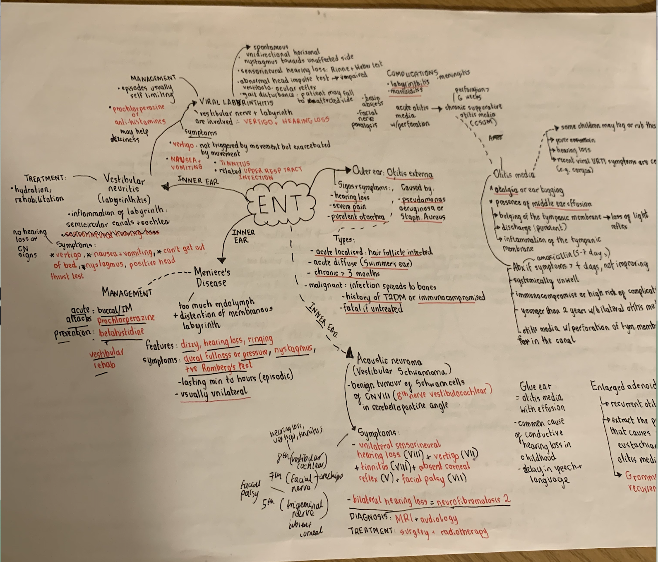
System based mind maps
Excellent for spotting the overlapping features and differences between conditions
Helps with differential diagnoses
Main subject areas covered are signs and symptoms, management , complications

Slide 9
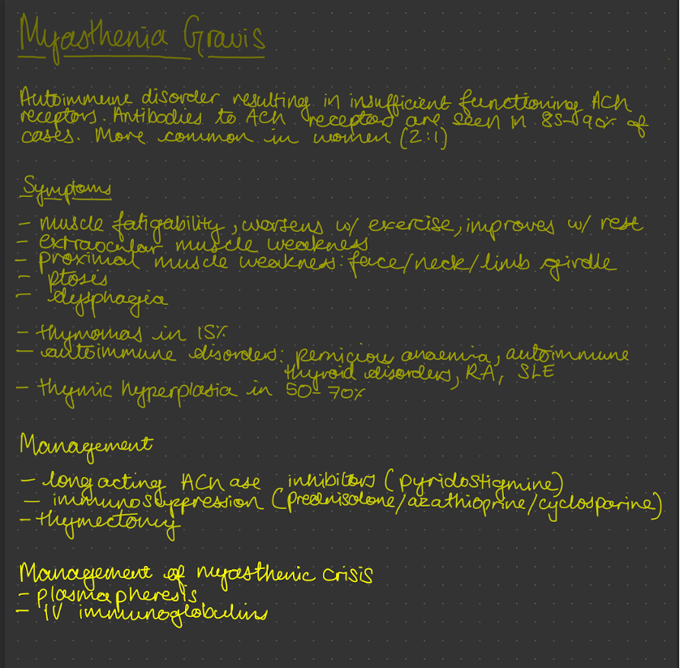
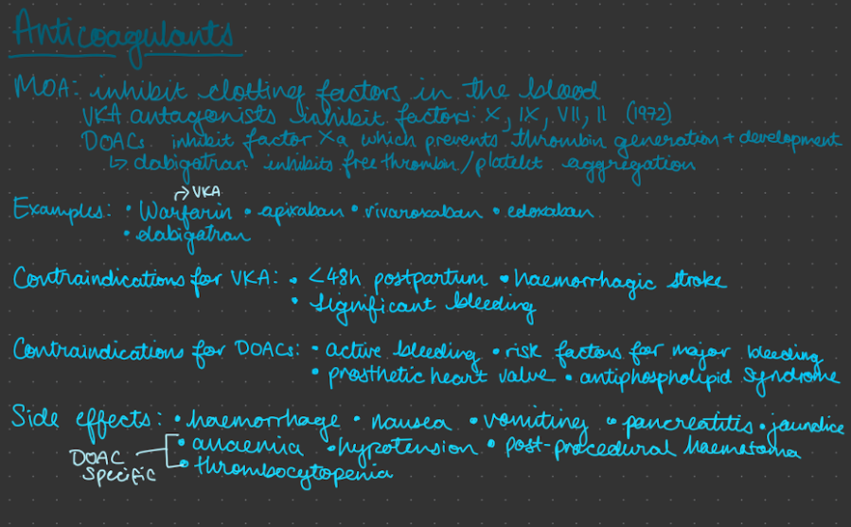
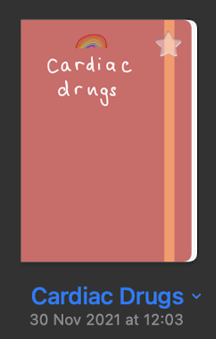
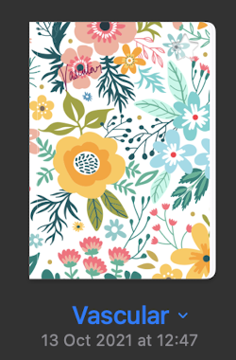
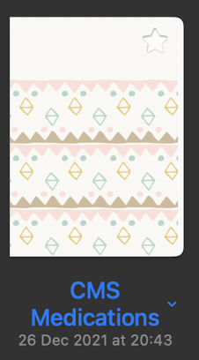
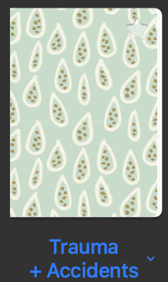
disease-specific
medication-specific
Note-Taking
I split my notes up via the block that they fall under :)
Don’t forget about GP and Mental Health!

Slide 10
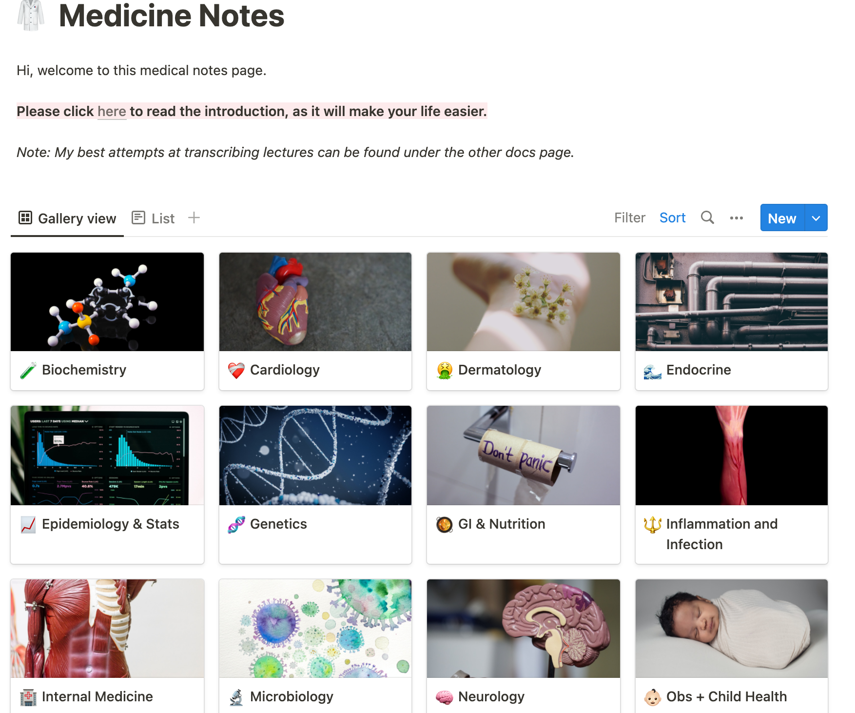
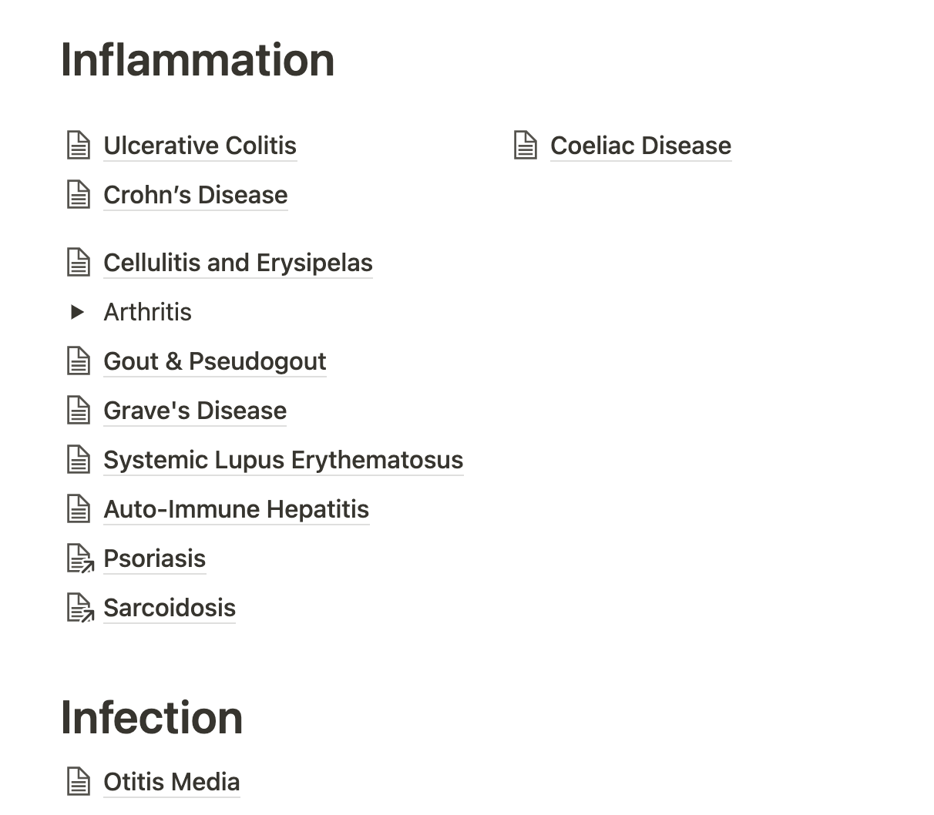
Notion and Note Taking

Slide 11
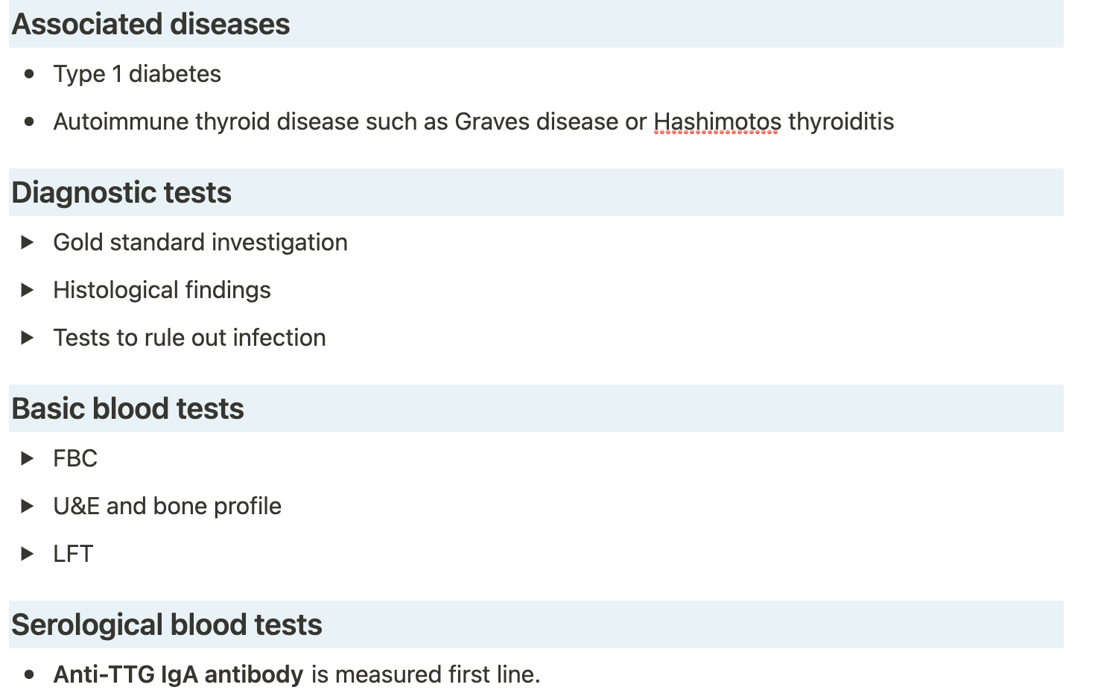
Notion and Note Taking
Resources used to create these notes:
Quesmed
Passmed
Zerotofinals
BMJ Best Practice
NICE Clinical Knowledge Summaries
the toggle feature is great for testing your knowledge as it temporarily conceals further information!

Slide 12
Quesmed and Passmed
Easier to view progress
Has a daily target of spaced repetition cards
Explanations tend to be more brief
£10 per month // £30 per 6 months // £40 per year
Black Friday Sale!
Recommend using Core Clinical Mock Tests
Passmed Textbook is more comprehensive than Quesbook
Questions are slightly harder (anecdotally)
Explanations are more detailed
Spaced repetition system is not as effective
£15 per 4 months // £20 per 6 months // £25 per 9 months // £30 per year
Year 1-3 QBank is free (and just as good!)

Slide 13
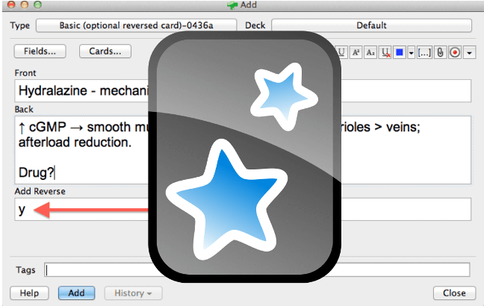
Quizlet and Anki
Best for short term memory (aka last minute cramming)
Much much nicer UI
Games to learn with
Can’t import Anki decks into Quizlet
Better for long term memorisation
Customisable with various modifications
Better for anatomy as you can label pictures
Possible to import Quizlet decks into Anki
Some Stage 2 blocks have been made public Ankis (Thank you Josh)

Slide 14
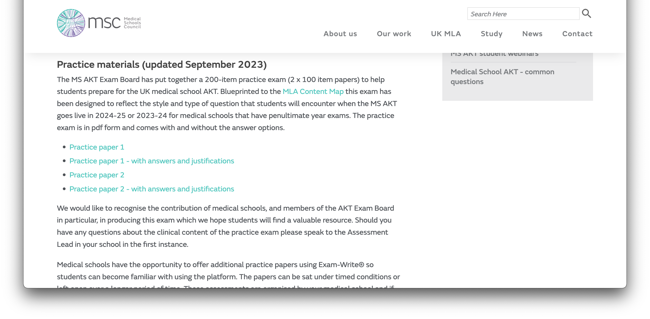
Progress Test Practice

Slide 15
Approaching Exam Questions
Knowing the answer is the best way to get a question right!
Otherwise just narrowing your chances from 20% to 50% is a good method
Keep in mind what the single best answer is out of the given options
Read the question before even looking at the multiple choices!

Slide 16
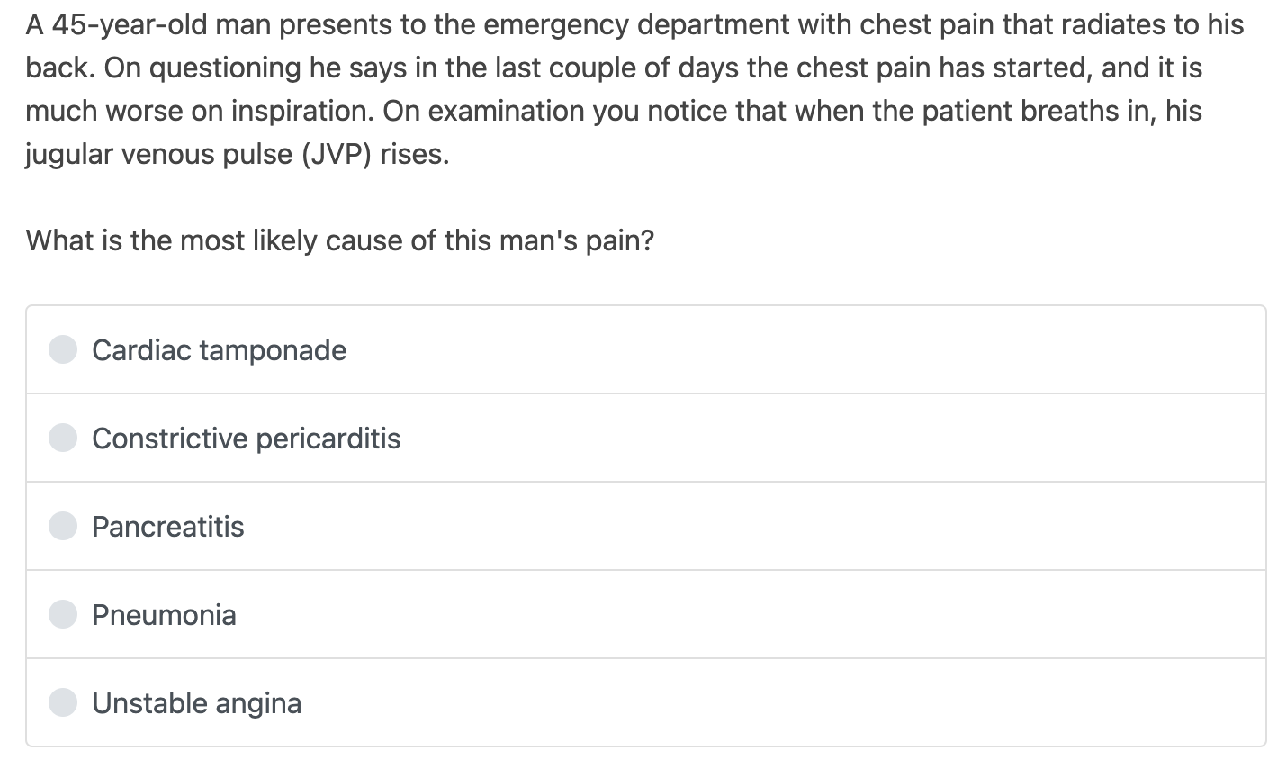
Example Question
Most likely would include ECG abnormalities in the stem like electrical alternans or small QRS complexes globally
Would it cause chest pain? Particularly chest pain worse on inspiration?
No other signs of infection like a fever or a productive cough
Angina is narrowing of coronary arteries, would it cause pain worse on inspiration?

Slide 17
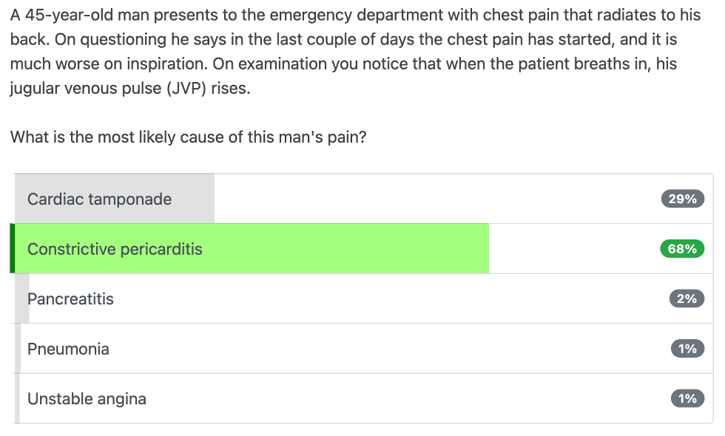
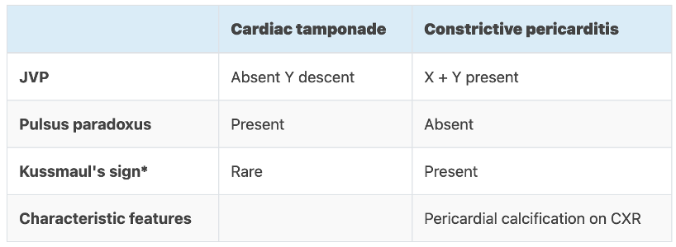

Slide 18
General Advice
Once you have learned a condition, test your understanding with practice questions
Group learning can be beneficial but prioritise and make time for private study
Make use of the progress test feedback?????
Triads and mnemonics will be your best friends!
GKTeach sessions – starting next week
Societies revision sessions

Slide 19
Useful resources
UKMLA content map is your new conditions list!
Quesmed
Passmed
BMJ Best Practice
NICE Guidelines & Clinical Knowledge Summaries
Anki
Notion
Medical Schools Council Past Papers (found on Keats)
Oxford Clinical Handbook of Medicine (Cheese and Onion Book)

Slide 20
Any Questions? Feedback Form
Useful contacts:
msa@kcl.ac.uk
Follow GKT MSA on:
- Instagram: @gktmsa
- Facebook: www.facebook.com/gktmsa
- TikTok: @gktmedics
- Twitter: @gktmsa
https://forms.gle/MEP9J3zVmK5SBjxo7

